Slide 1
EMOTION BASED MUSIC PLAYBACK SYSTEM
Project Guide - Ms. T. Sindhu
Surya V
2019202057
MCA Regular
Batch - 2

Slide 2
Table Of Content
Overall Architecture
Modules
Output Screenshots
Evaluation And Testing
References

Slide 3
List of Modules
Pre-processing (Image Augmentation)
Creating and Training Model.
Face Detection from webcam.
Frontend Implementation
Backend Implementation
Music meta data extraction.
Mapping music to emotion.

Slide 4
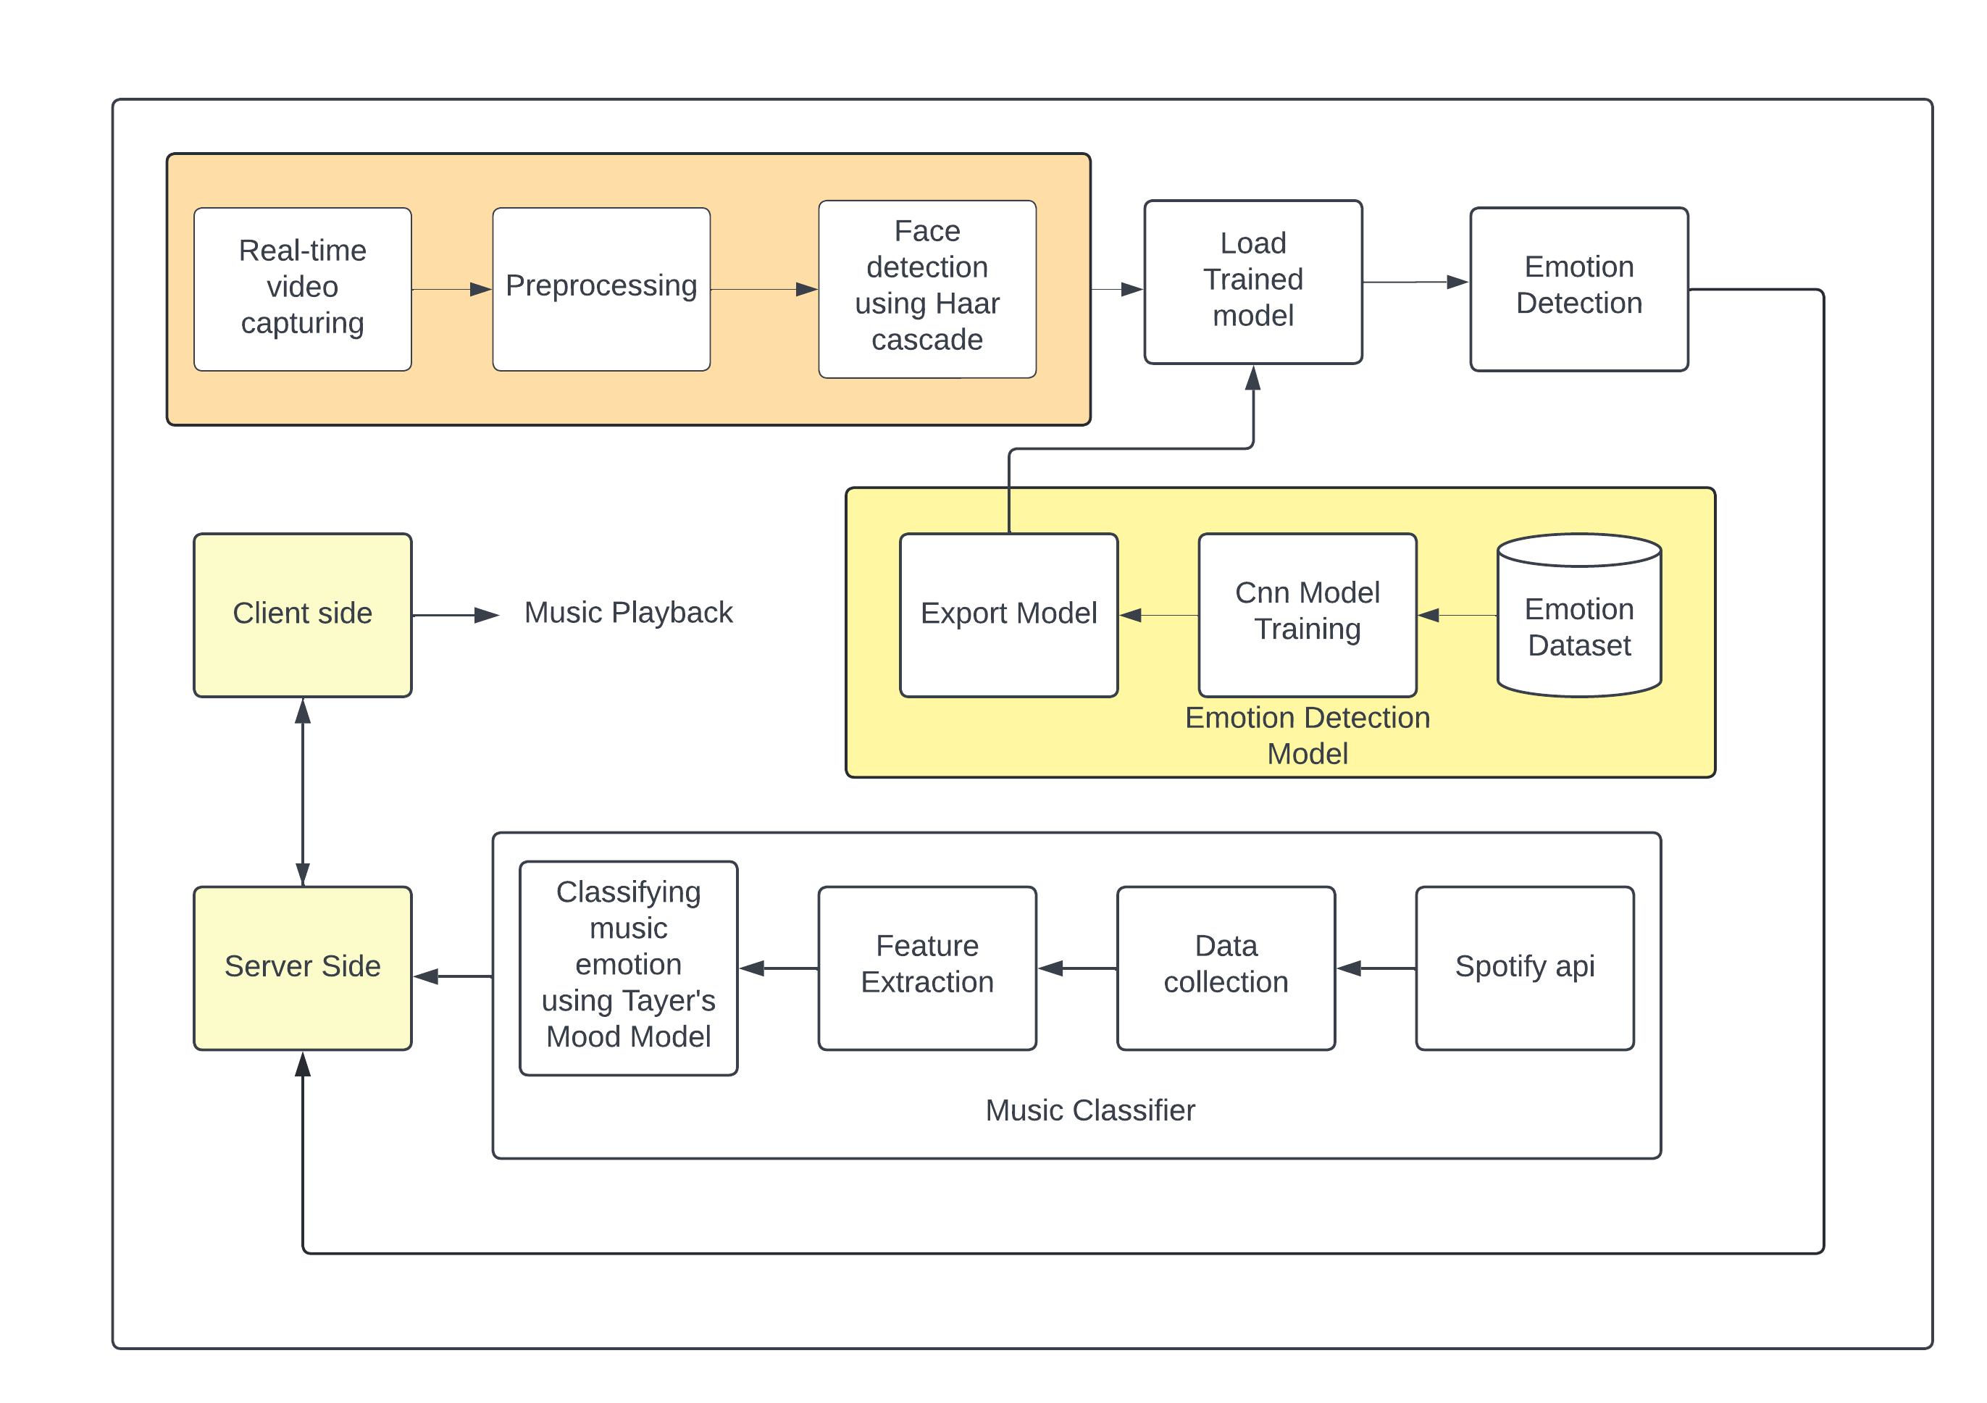
Overall Architecture

Slide 5
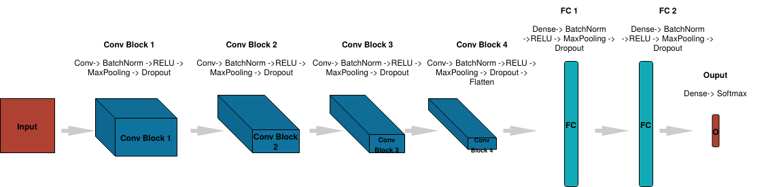
Creating and Training Model

Slide 6
Module Description
Input Image size = 48*48 grey-scale
It has four convolutional layers with size doubling every layer from 32.
Each layer has pooling layer of size of 3*3 with max-pooling.
Activation Function used is ‘ELU’
It has two dense or fully-connected layer with 2304 nodes
Finally we have final dense layer or output layer with 5 nodes classifying happy, sad, angry etc..

Slide 7
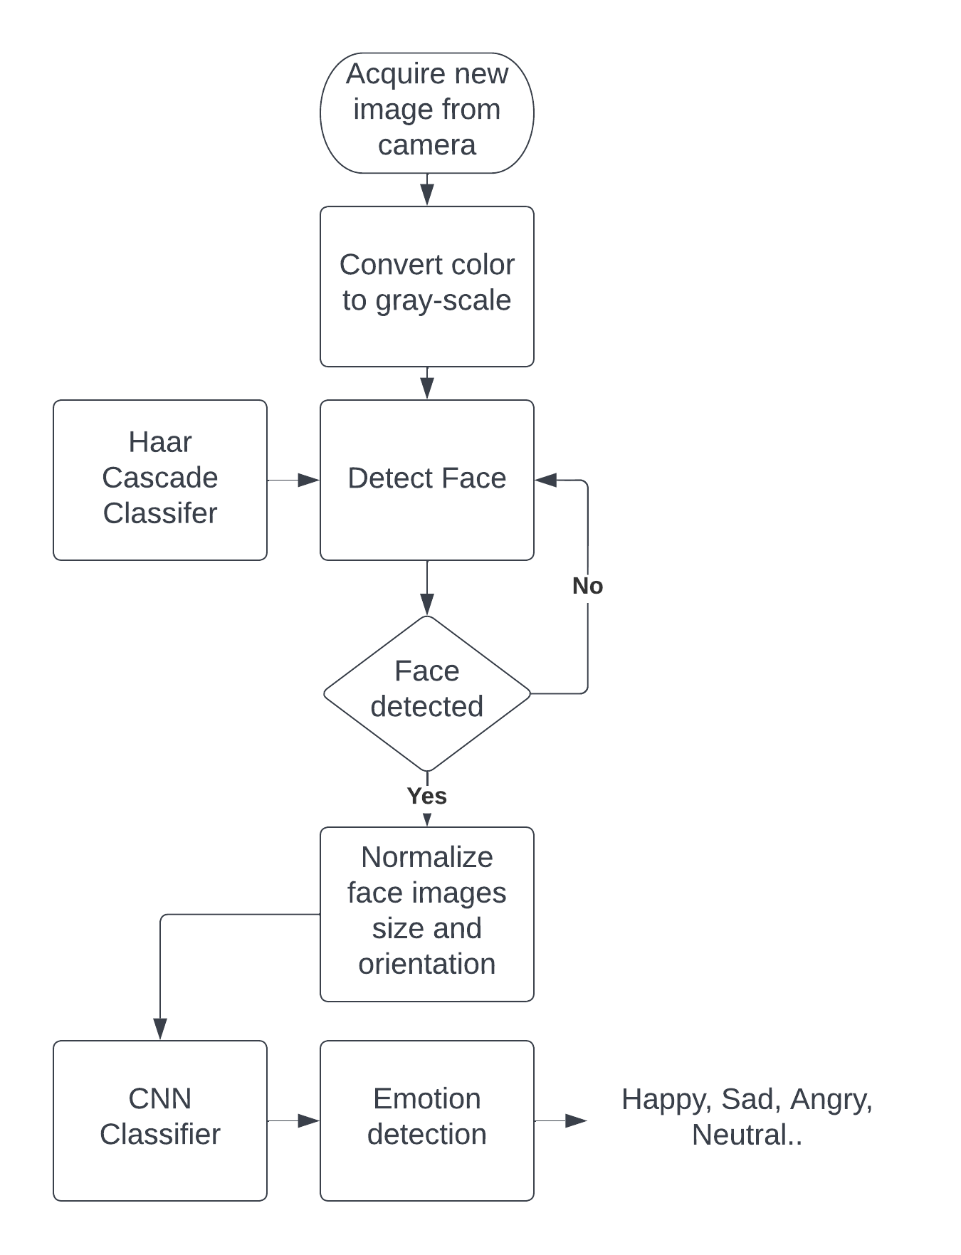
Face Detection
Input a video
Extract frame
Convert the frame into grey-scale
Apply Haar-cascade filter to detect edge, line etc.
Normalize face image size after detecting
Draw bounding box on the detected face.

Slide 8
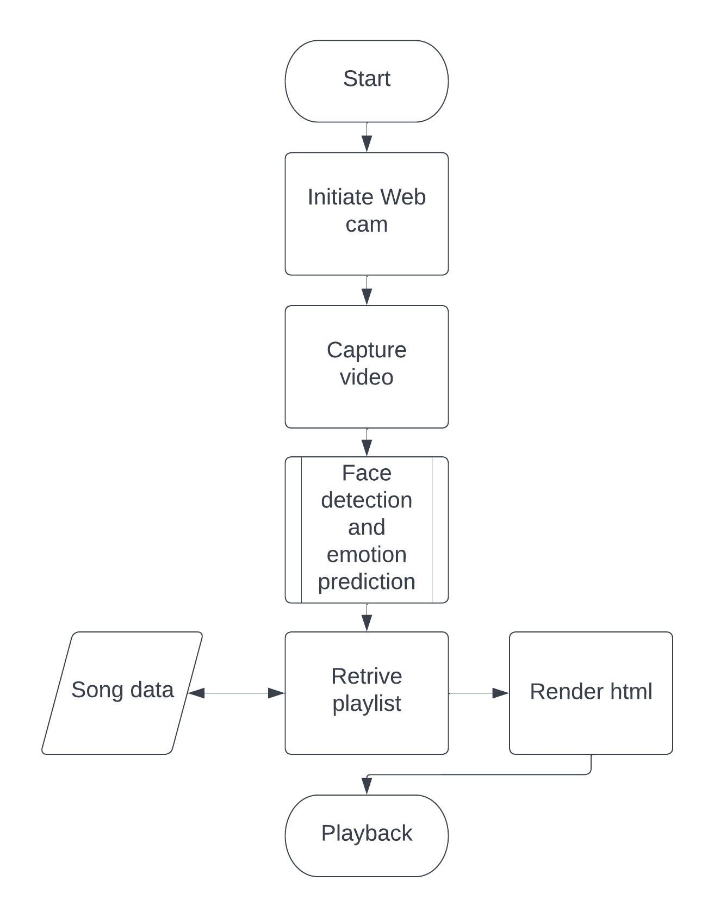
Web Development
Initiate Web cam to capture the video of the user
Detect face and predict the emotion using model file stored in the server.
Redirect to the playlist page based on emotion
Retrieve list of songs from the classified song data and render the content in html

Slide 9
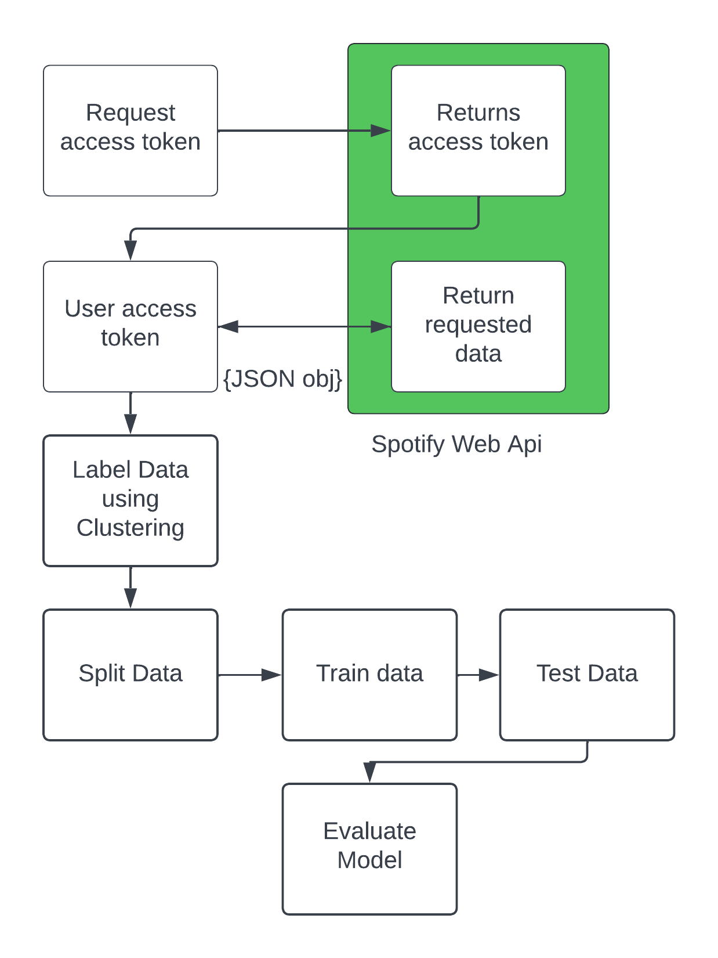
Music Emotion Classification
Retrieve songs from playlist using spotify api
Retrieve metadata of each song
Pre-process data to remove unwanted and null entries.
Label data using Tayer’s mood model and group songs.
Split the data to train and test the model using classifier like random forest etc..
Evaluate the model.

Slide 10
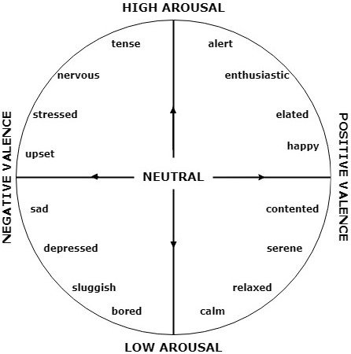
Audio Features
Acousticness
Arousal
Danceability
Energy
Liveliness
Loudness
Valence
Tempo tempo valence

Slide 11
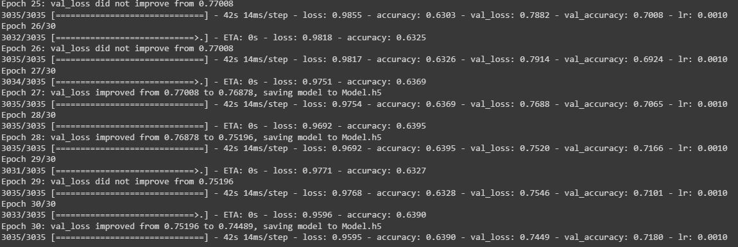
Module Based Output
Trained model for a epoch of 30 and got validation accuracy of 71.8%. Improved accuracy of 6.8%

Slide 12
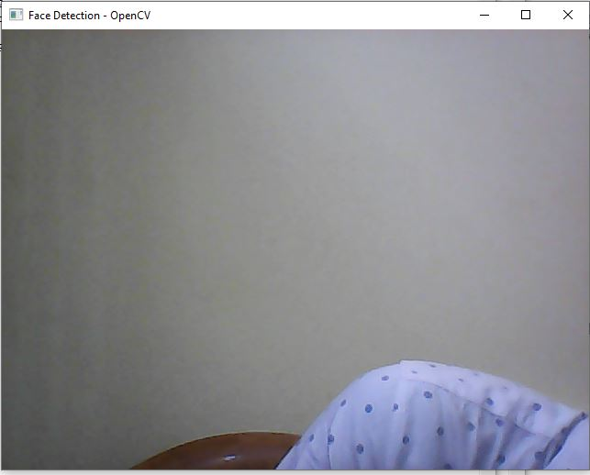
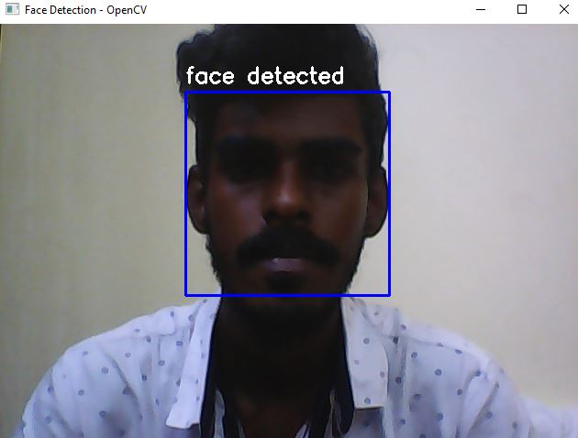
Module Based Output
Face Detected when a person appears.

Slide 13
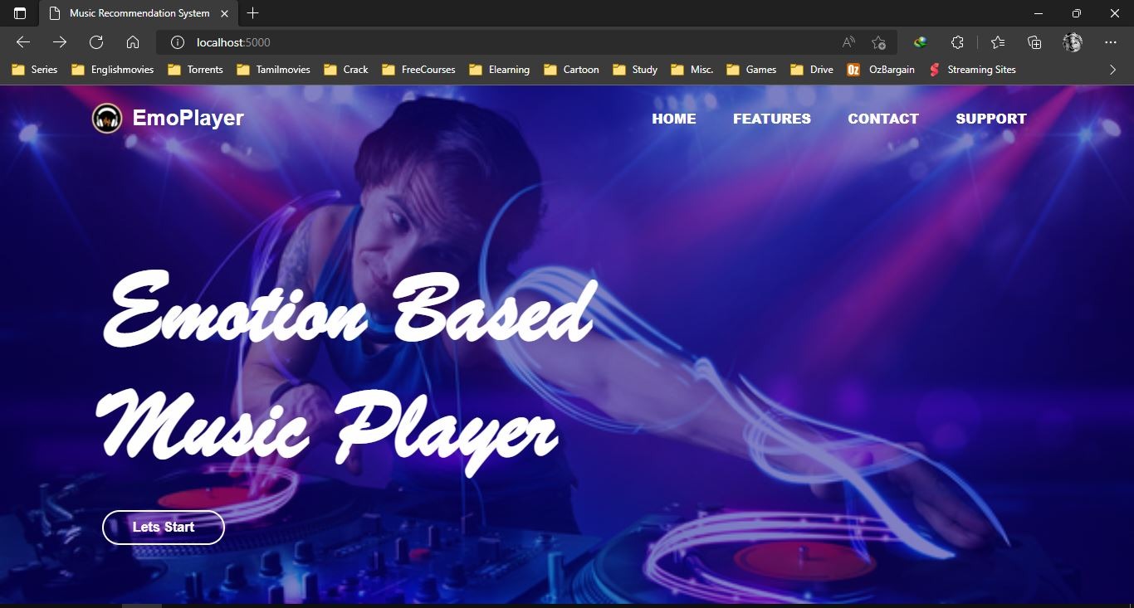
Module Based Output
Website running on localhost with flask server.

Slide 14

Thank you!

